Slide 1

OdontoVision AI Interactive Educational Application in Odontogenic Oral Pathology

Slide 2

Project Overview
AI-powered educational platform for dental students
Focused on Odontogenic Oral Pathology
Integrates AI, Firebase and interactive learning
Includes AI Oral Pathology Tutor chatbot
Includes AR learning, 3D dental models, and faculty analytics

Slide 3

Objectives
Develop an interactive mobile learning platform
1
Implement AI Oral Pathology Tutor chatbot
2
Generate quizzes automatically from PDFs & images
3
PROVIDE FACULTY LECTURE UPLOAD & QUIZ SOLUTION
4
MONITOR STUDENT PERFORMANCE & ANALYTICS
5
EXPLORE AR & 3D VISUALIZATION TECHNOLOGIES
6

Slide 4
Development Methodology
Requirement Analysis
UI/UX Design
Firebase Integration
Gemini API Integration
AR/3D Module Development
System Integration
Testing and Evaluation

Slide 5
System Architecture
Frontend Layer
Backend Layer
AI Layer
Storage Layer

Slide 6

Frontend Layer

Slide 7

Technologies Used
Native Android Development
Java
XML Layouts

Slide 8

Modules
Student Dashboard
Faculty Dashboard
Login and Registration
AI Oral Pathology Tutor
Quiz Generator
PDF Upload System
AR Learning Module
3D Model Viewer
Performance Reports

Slide 9
Backend Layer

Slide 10
Technology Used
Firebase Authentication
Firestore
Room Database
Shared Preferences
Gemini API

Slide 11
Functionalities
User Authentication
Role-Based Navigation
PDF Upload and Retrieval
Quiz Generation Requests
Chatbot Communication
Performance Analytics

Slide 12
AI Layer
Technologies Used
Processes
Google Gemini API
Google AI Studio
Prompt Engineering
AI Chatbot Responses
Automatic MCQ Generation
Educational Content Understanding

Slide 13
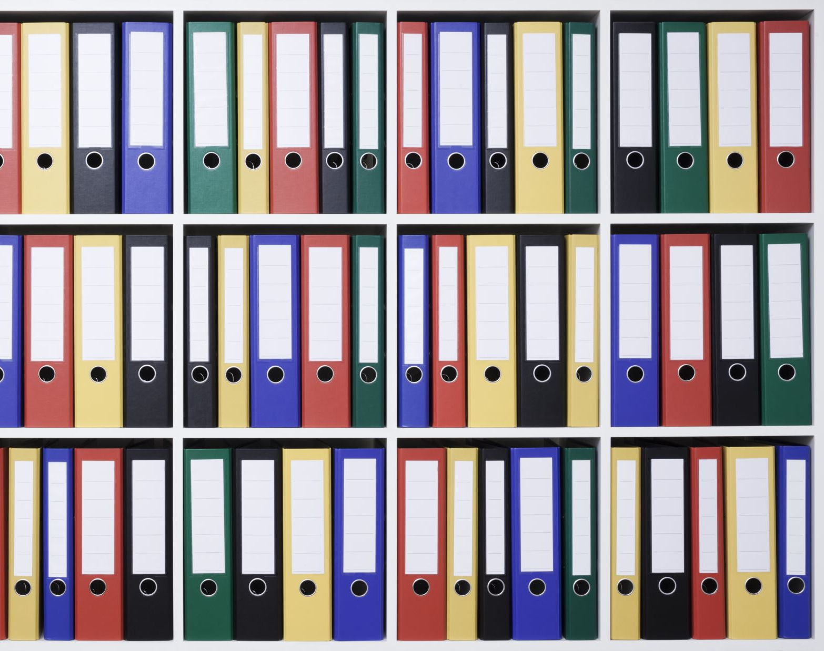
Storage Layer
User Profiles and Roles
Uploaded Lecture PDFs
Quiz Solution Files
Quiz Attempts and Score

Slide 14

Key Features
AI Oral Pathology Tutor
Faculty Lecture PDF Upload
Automatic Quiz Generation
Quiz Solving Module
Faculty Uploaded Quiz Solutions
Student Performance Reports
Faculty Dashboard
AR Learning Module
Interactive 3D Dental Models

Slide 15

Results and Discussion
Successfully integrated Artificial Intelligence into dental education
AI Oral Pathology Tutor provided accurate exam-oriented explanations
Automatic quiz generation improved assessment preparation
Faculty dashboard enabled lecture uploads and performance monitoring
Student performance reports identified weak areas
AR and 3D modules improved anatomical visualization and understanding

Slide 16
Conclusion
Developed an intelligent mobile educational platform for dentistry
Enhanced student understanding and examination preparation
Provided AI tutoring, quiz generation, faculty analytics, and AR learning
Demonstrated practical application of AI in dental education

Slide 17
Future Enhancements
Real-time voice-based AI tutor
Full ARCore integration
Advanced disease-specific 3D models
Adaptive personalized quizzes
Offline learning mode
Cloud synchronization across devices
Multi-language educational support

Slide 18

Thank You

